Slide 1
Schematic Design
Altium Designer has been used!
No galvanic isolation is needed!
Some extra components are used which are not discussed in component selection part!

Slide 2
Schematic Design
IntVCC Pin: To maintain internal VCC, datasheet recommends minimum 2.2uF ceramic capacitor. 4.7uF capacitor is used.
Bias Pin: This pin takes internal supply from output, 4.7uF ceramic capacitor is recommended.
Smode Pin: For standby operation, grounded for normal operation.

Slide 3
Schematic Design
VC Pin: For loop compensation. Datasheet recommends an R-C network to stabilize the operation generally with 20kohm and 220nF. However demo board uses 10kohm and 100nF, and when we compare these two, 10kohm and 100nF R-C networks gives better transient response.
IREG/SS Pin: For output current regulation. The formula in the datasheet gives us a 50kohm resistor to regulate output current at 8.33A.
TC Pin: For temperature compensation, experimentally adjusted. We have taken demo board value 121kohm and connected to FB pin.

Slide 4
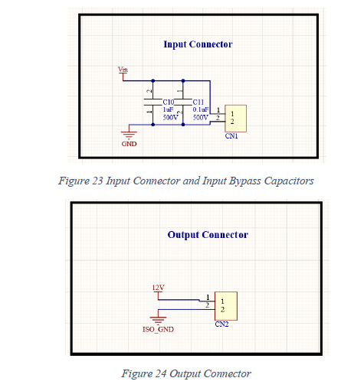
Schematic Design
We have used inut bypass capacitors to eliminate any possible high frequency noises.
We have used 20 ohm MOSFET gate resistor to limit dI/dt in the gate, for safe switching.
We have used 10kohm gate pull-down resistor for safety.

Slide 5
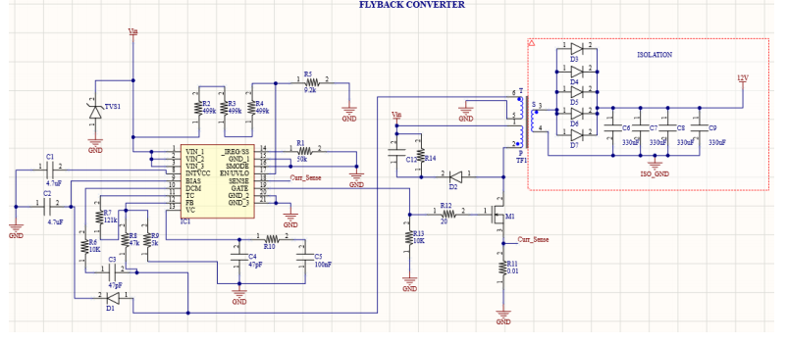

Slide 6
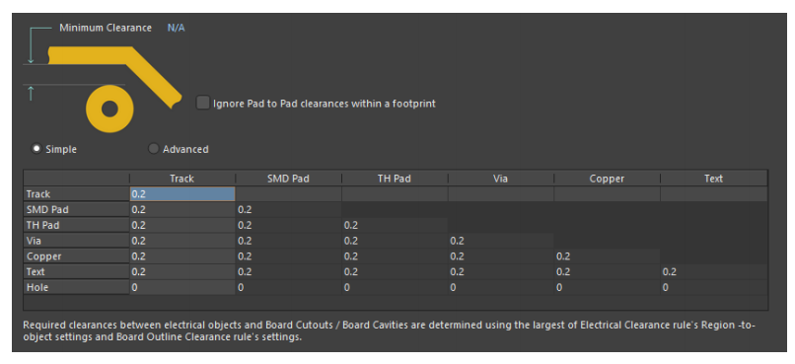
PCB Design
Rules and Validations
According to IPC2221B, 0-15V clearance should be minimum 0.1mm
300-500V should be minimum 2.5mm for bare PCB, 0.8mm for coated PCB

Slide 7
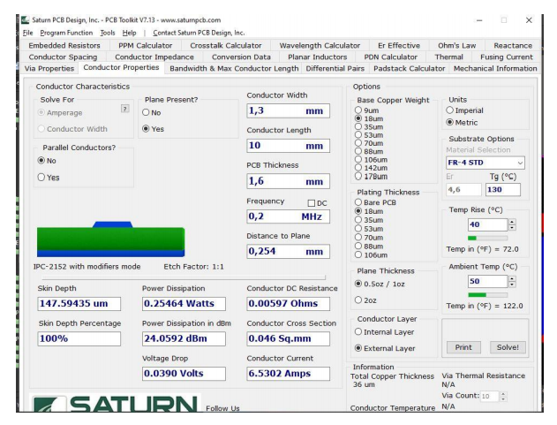
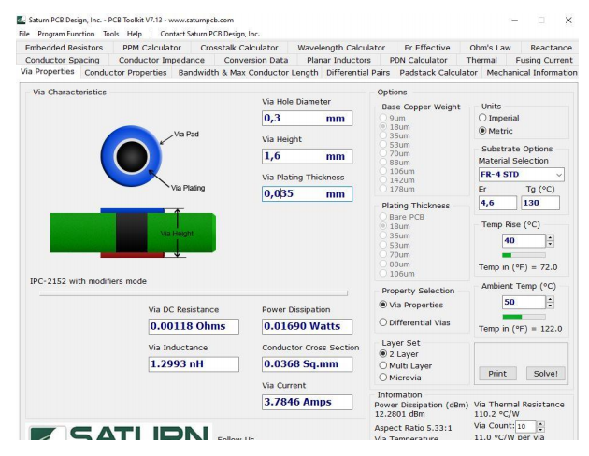
PCB Design
Input Minimum Line Width: 1.3mm (6.5A)
(5A Max.)
Input Minimum Via hole: 0.3mm (3.78A)
Via’s are used as pairs!

Slide 8
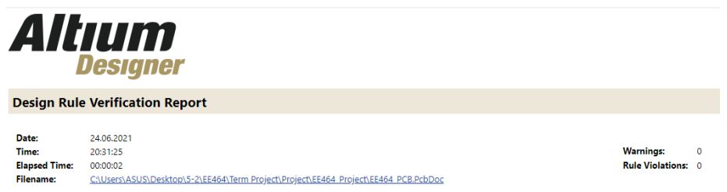
PCB Design
Design Rule Check

Slide 9
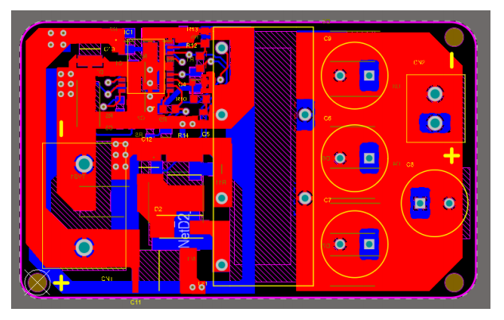
2D Design
Two isolated sides (Left: Input, Right:Output)
0.4mm spacing with board borders
Positive and negative terminal markings for safety! (Protection Circuit Bonus)

Slide 10
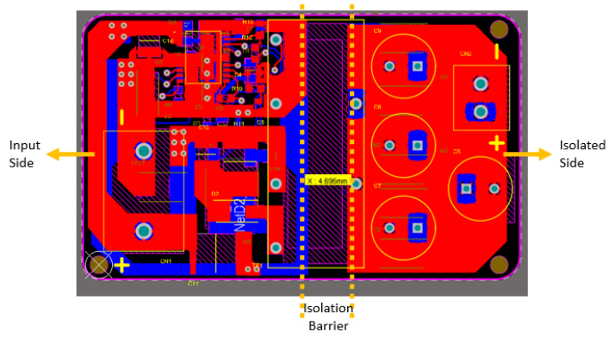
2D Design
According to IPC2221B, 4.7mm isolation is capable up to 940V in bare PCB and 1750V in coated PCB
We have designed for coated PCB!

Slide 11
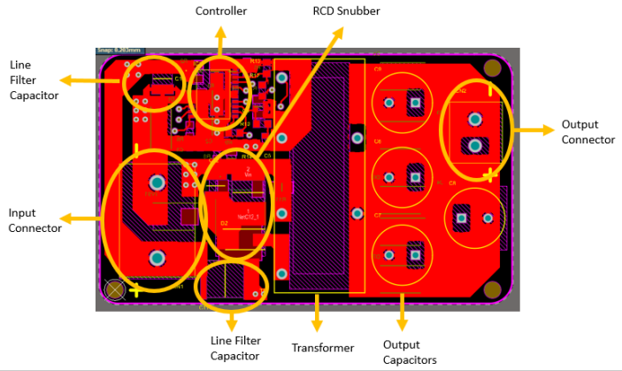
2D Design

Slide 12
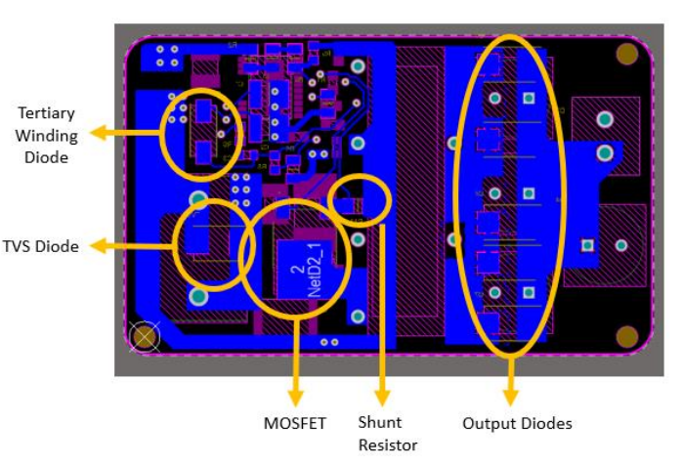
2D Design

Slide 13
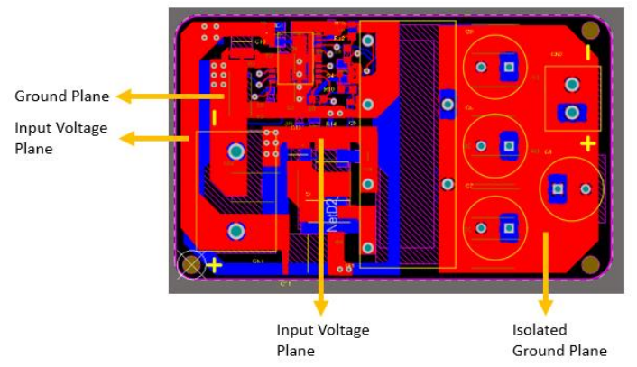
2D Design

Slide 14
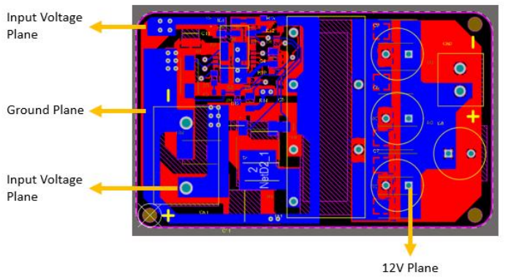
2D Design

Slide 15
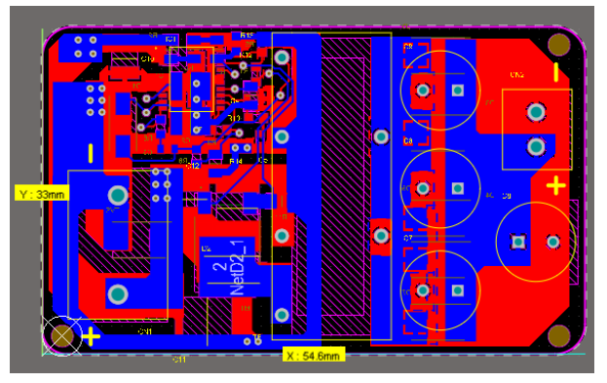
2D Design
Dimensions
33mm x 54.6mm

Slide 16
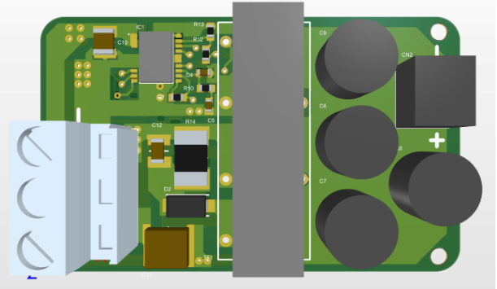
3D Design
3D Models are placed
Compact and Industrial Product!
Top Layer

Slide 17
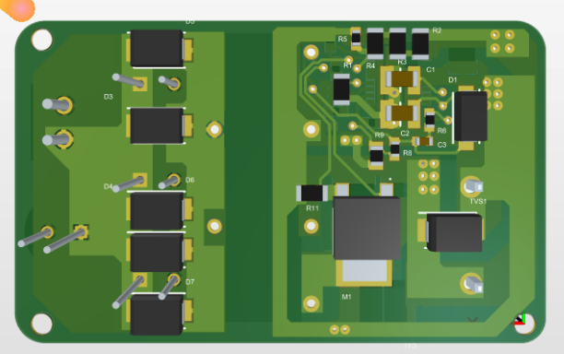
3D Design
Bottom Layer:

Slide 18
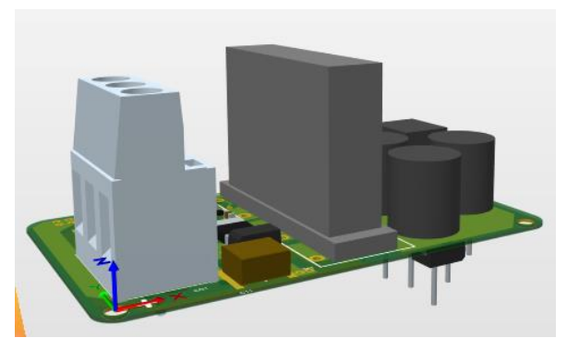
3D Design
Side View:

Slide 19
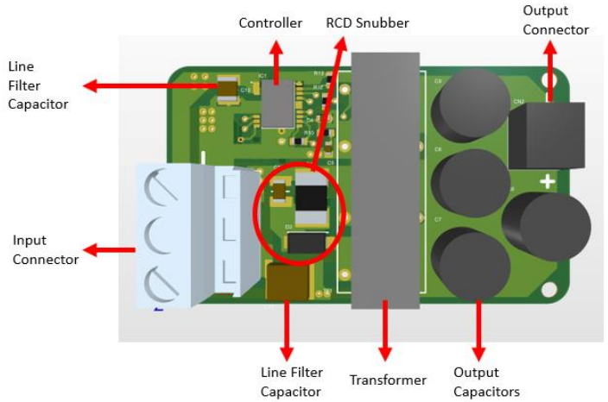
3D Design

Slide 20
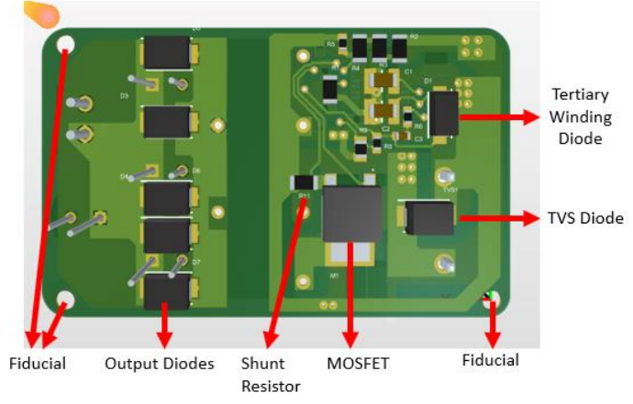
3D Design

Slide 21
3D Design
PCB Material Selection:
18um Base Copper + 18um Plating Thickness (1 oz Copper)
FR-4 Material (low conduction loss compared to Aluminum)
1.6mm Card Thickness

Slide 22
3D Design
Dimesions:
Top Layer Highest Component: 20.25mm (Transformer)
Bottom Layer Highest Component: 3.2mm (Output Diode)
Card Thickness: 1.6mm
Total: 23.05mm z-axis → Dimensions: 54.6mm x 33mm x 23.05mm Volume: 41531.49 mm3
Box is designed with margins: 64mm x 40mm x 30mm Volume: 76800 mm3 (Industrial Design Bonus)

Slide 23
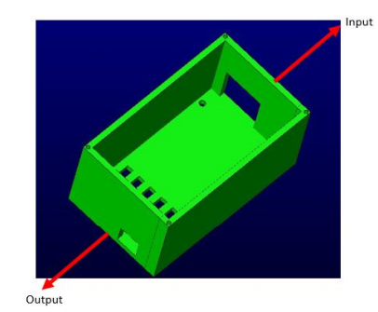
Box Design
Box has screw holes for fiducials
There are 6 opening at bottom side for airflow to output diodes
Box cover is connected with metric 1.5 screws

Slide 24
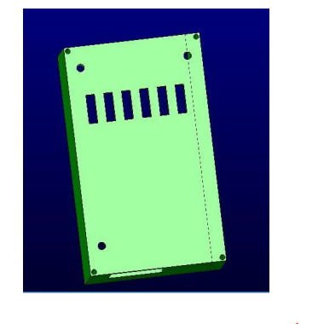
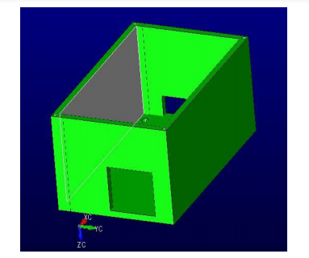
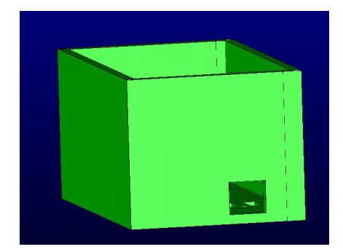
Box Design
Bottom View
Input View
Output View

Slide 25
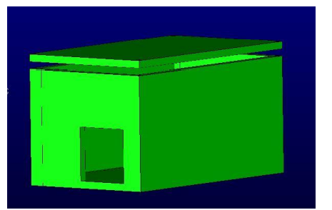
Box Design
Box with Cover

Slide 26
Hardware Design Conclusion
Design Rules
Line-Via Currents
Components
Isolation Boundary
Card Material
Copper Thickness

Slide 27
Cost Analysis
Component Price: 9.78$
PCB Price: 0.197$
Litz Wire: 3.9$
Total Cost for one PCB: 13.88$ (Cheapest Design Bonus)

Slide 28
Martian Power Solutions
Enhanced Simulation
Enhanced Magnetic Design
Power Loss and Thermal Calculations
Hardware Design
Cost Analysis

Slide 29

Thank You!
SPOILER ALERT!

